Slide 1

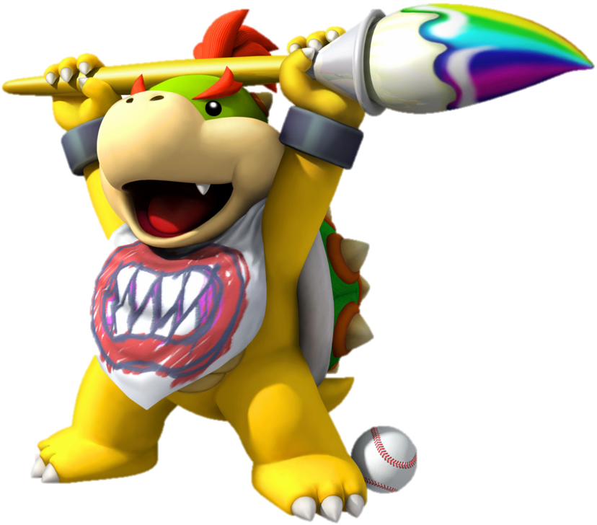
Graphics API
HTML drawing
Notes:
© SUPINFO International University - http://www.supinfo.com
SUPINFO vous permet de partager ce document
Vous êtes libre de :
Partager — reproduire, distribuer et communiquer ce document Remixer — modifier ce document
A condition de respecter les règles suivantes :
Indication obligatoire de la paternité — Vous devez obligatoirement préciser l’origine « SUPINFO » du document au début de celui-ci de la même manière qu’indiqué par SUPINFO International University – Notamment en laissant obligatoirement la première et la dernière page du document, mais pas d'une manière qui suggérerait que SUPINFO International University vous soutiennent ou approuvent votre utilisation du document, surtout si vous le modifiez. Dans ce dernier cas, il vous faudra obligatoirement supprimer le texte « SUPINFO Official Document » en tête de page et préciser notamment la page indiquant votre identité et les modifications principales apportées.
En dehors de ces dispositions, aucune autre modification de la première et de la dernière page du document n’est autorisée.
NOTE IMPORTANTE : Ce document est mis à disposition selon le contrat CC-BY-NC-SA Creative Commons disponible en ligne http://creativecommons.org/licenses ou par courrier postal à Creative Commons, 171 Second Street, Suite 300, San Francisco, California 94105, USA modifié en ce sens que la première et la dernière page du document ne peuvent être supprimées en cas de reproduction, distribution, communication ou modification. Vous pouvez donc reproduire, remixer, arranger et adapter ce document à des fins non commerciales tant que vous respectez les règles de paternité et que les nouveaux documents sont protégés selon des termes identiques. Les autorisations au-delà du champ de cette licence peuvent être obtenues à support@supinfo.com.
© SUPINFO International University – EDUCINVEST - Rue Ducale, 29 - 1000 Brussels Belgium . www.supinfo.com

Slide 2

Course objectives
Graphics API
By completing this course you will be able to:
Understand graphics API concept
Draw shapes with SVG
Draw shapes with Canvas
Choose one or the other depending on what you need to do

Slide 3

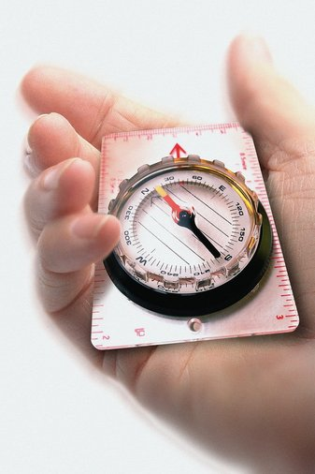
Course plan
Graphics API
SVG
Canvas
SVG or Canvas ?

Slide 4
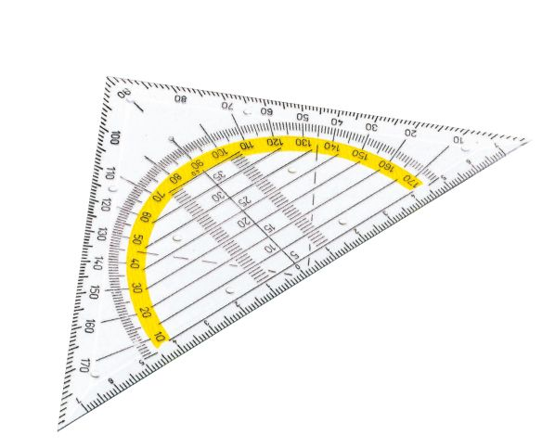
SVG
Graphics API

Slide 5

Presentation
SVG
Graphics in HTML5
Done by markups
Simple and quick rendering
Suitable for lightweight graphics
Preferred for static design
Already recommended by W3C

Slide 6
History
SVG
In the late nineties, there were two different markup languages for graphics:
PGML (Precision Graphics Markup Language)
Created by Adobe
Supported by IBM, Netscape and Sun
Based on PDF and PostScript formats
VML (Vector Markup Language)
Created by Microsoft, Macromedia, Autodesk, Hewlett-Packard and Visio
Implemented in Internet Explorer, Microsoft Office and Silverlight
Notes:
http://fr.wikipedia.org/wiki/Scalable_Vector_Graphics

Slide 7
History
SVG
The war between these two formats was bad for developers usage
W3C spent a long time to define a normalization and take advantages from both of them
In 2000, SVG 1.0 specification was born ! ☺
Now SVG 1.1 is natively supported by all major browsers
Notes:
http://www.gchagnon.fr/cours/xml/svg.html#histosvg

Slide 8
Syntax
SVG
Tag <svg>
Acts as a <div> element
Can contain several shapes
One tag by shape: <circle>, <line>, …
Enhanced by attributes
Specify origins, and dimensions

Slide 9
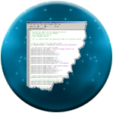
The SVG tag
SVG
The <svg> tag
Root element for your shapes defined inside
Their coordinates will be calculated from the SVG top left corner element
<svg xmlns="http://www.w3.org/2000/svg" version="1.1">
<!–- Your shapes here -->
</svg>

Slide 10
Line
SVG
Used to draw a line:
x1 and y1 for departure coordinates
x2 and y2 for arrival coordinates
<line x1="0" y1="0" x2="600" y2="600" fill="black" />

Slide 11

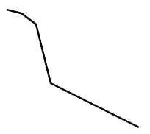
Polyline
SVG
Special line including many points:
Without fill attribute, just a multi-pointed line:
<polyline
points="0,10 20,10 30,20 50,0 70,20
90,0 110,20,120,10 150,10"
fill="red" stroke="black" stroke-width="3" />
<polyline points="20,20 40,25 60,40 80,
120 120,140 200,180"
style="fill:none;stroke:black;
stroke-width:3" />

Slide 12
Rect
SVG
Used to draw a rectangle:
x and y for coordinates
width and height for dimensions
<rect x="550" y="0" width="300" height="400" fill="black" />

Slide 13
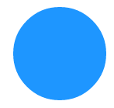
Circle
SVG
Used to draw a circle:
cx and cy for coordinates
r for radius
<circle cx="60" cy="60" r="30" fill="rgba(30, 150, 255, 1)" />

Slide 14

Ellipse
SVG
Almost same than circle:
cx and cy for coordinates
rx and ry for radius
<ellipse cx="60" cy="60" rx="30" ry="60" fill="blue" />

Slide 15
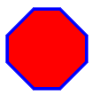
Polygon
SVG
Designs shapes with at least three points:
Unlike polyline, all the lines connect up (ex: the first and the end point is connected)
Same attributes than polyline
<polygon points="40,10 70,10 100,40 100,70
70,100, 40,100 10,70, 10,40"
style="fill: red; stroke: blue; stroke-width: 4;" />

Slide 16

Text
SVG
Outputs a simple text:
Mostly like a <span> element, but in SVG!
Can be reshaped thanks to the « transform » attribute
<text x="15" y="15" fill="brown"
transform="rotate(45)"
style="font-size: 24px;" >
Take me to the top!
</text>

Slide 17

Text
SVG
Outputs a simple text:
If you want to jump lines, enclose each line by the <tspan> tag and specify their coordinates!
x and y is related to the svg container’s coordinates
dx and dy is added to the previous element’s coordinates
<text y="15" fill="brown" transform="rotate(45)"
style="font-size: 24px;" >
<tspan x="75">SVG</tspan>
<tspan dy="20" x="75">is soooo</tspan>
<tspan dy="20" x="75">cool</tspan>
</text>

Slide 18
Filters
SVG
SVG also provides filters!
Simple tags to apply over SVG components
Change shapes, colors, opacity, …
Useful for animations and picture retouching!
Can be defined two ways:
By the « filter » CSS property
Directly in the shape tag (circle, rect, …)

Slide 19
Filters
SVG
Filters are encapsulated inside the <defs> tag
Containing all definitions for filters and gradients
Usage:
<svg xmlns=... >
<defs>
<!–- Filters and/or gradients -->
</defs>
<rect ... />
</svg>

Slide 20
Filters
SVG
In order to use your filters:
Define an id for each of them:
Link the filter to your shape thanks to the filter attribute:
<filter id="filter1" ... >
<!–- My filter –->
</filter>
<rect width="90" height="90" fill="yellow"
filter="url(#filter1)" />

Slide 21

Filter common attributes
SVG
Four optionnal attributes to remember:
You must specify their values in percentages
These attributes can truncate your SVG shape
Property | Default | Use
x | 0% | Moves the filter at right
y | 0% | Moves the filter at bottom
width | 100% | Specify the x-length of the filter
height | 100% | Specify the y-length of the filter
Notes:
Note : x and y don’t take fill-stroke attribute in consideration. Remove them if you planned to use this attribute, otherwise your border will be truncated.

Slide 22
Filter common attributes
SVG
Look at the following schema, and the example:
x
y
width
height
<filter id="filter1" x="20%" y="50%" width="70%" height="50%">
<!–- Some effects -->
</filter>

Slide 23

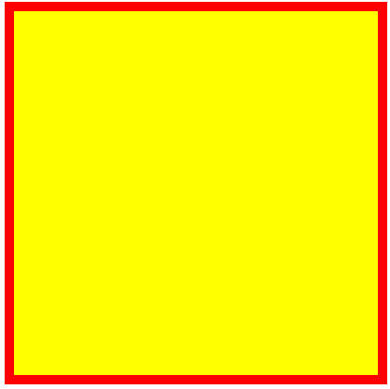
Filters
SVG
For the next examples, we’ll consider a single shape in our SVG element, described as follows:
<svg>
<defs>
<filter id="f1">
<!–- We’ll define our effects here -->
</filter>
</defs>
<rect width="400" height="400" x="10" y="10"
stroke-width="10" stroke="red"
fill="yellow" filter="url(#f1)" />
</svg>
Notes:
Some filters example here: http://www.html5rocks.com/en/tutorials/filters/understanding-css/

Slide 24
Effects
SVG
Many effects are available in SVG:
Flood
GaussianBlur
ColorMatrix
…
We’ll concentrate on these three!
Here is the complete list:
http://www.w3.org/TR/SVG/filters.html

Slide 25
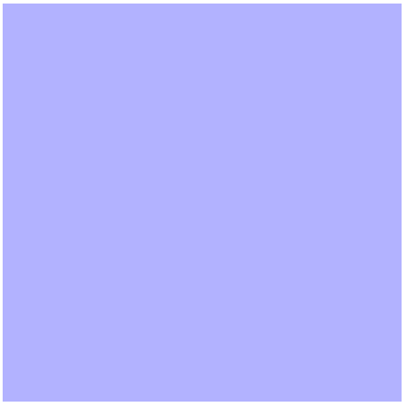
FeFlood
SVG
Covers the shape with the specified color:
Be careful: this will override fill and fill-stroke property
<feFlood flood-color="blue" flood-opacity=".3" />

Slide 26
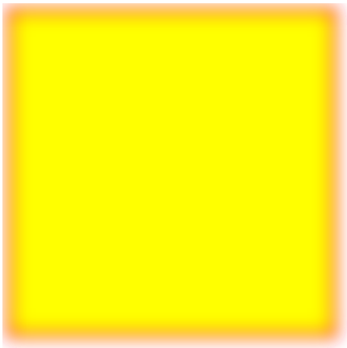
FeGaussianBlur
SVG
Performs on a gaussian blur:
Depending on the stdDevitation attribute
<feGaussianBlur stdDeviation="10" />

Slide 27
FeColorMatrix
SVG
Change your colors by:
HUE
Saturation
Luminance
A complete matrix
Here is a tool for better understanding:
http://www.colorsontheweb.com/colorwizard.asp

Slide 28
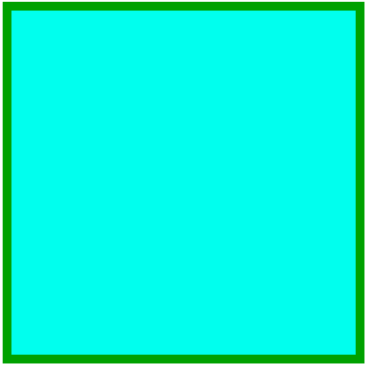
FeColorMatrix
SVG
HUE:
Takes one int argument as values
« Rotate » the base color
<feColorMatrix type="hueRotate" values="90" />

Slide 29

FeColorMatrix
SVG
Saturation:
Takes one real argument as values (from 0 to 1)
Saturates the base color
<feColorMatrix type="saturate" values="0.1" />

Slide 30
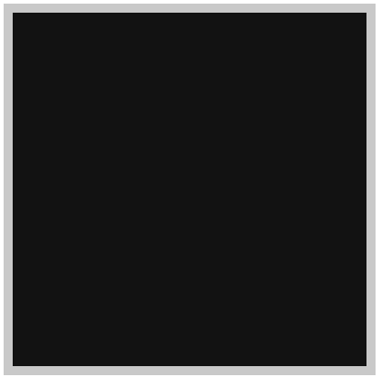
FeColorMatrix
SVG
Luminance:
Invert colors and associates them to a grey tone, depending on their luminance
<feColorMatrix type="luminanceToAlpha" />

Slide 31
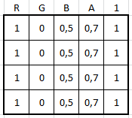
FeColorMatrix
SVG
Matrix:
Takes a complete 5 x 4 matrix:
Transforms base color by matrix multiplication
Example with a random base color: rgba(255, 0, 127, 0.7)
Transformed into matrix:
Notes:
More informations on matrix and svg look at these links:
http://www.svgbasics.com/filters4.html
https://dvcs.w3.org/hg/FXTF/raw-file/tip/filters/index.html#feColorMatrix

Slide 32
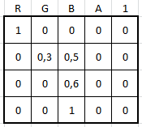
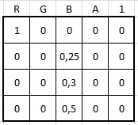
FeColorMatrix
SVG
Matrix reminders:
Let’s specify this random matrix:
Multiplication result:
Notes:
More informations on matrix and svg look at these links:
http://www.svgbasics.com/filters4.html
https://dvcs.w3.org/hg/FXTF/raw-file/tip/filters/index.html#feColorMatrix

Slide 33
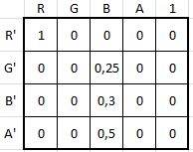
FeColorMatrix
SVG
Matrix reminders:
Now that we have the following result:
The resulting color will be:
Red = 255 x (1 + 0 + 0 + 0 + 0) = 255
Blue = 255 x (0 + 0 + 0.25 + 0 + 0) = 63
Green = 255 x (0 + 0 + 0.3 + 0 + 0) = 76
Alpha = 1 x (0 + 0 + 0.5 + 0 + 0) = 0.5
rgba(255,63,76,0.5)
Notes:
More informations on matrix and svg look at these links:
http://www.svgbasics.com/filters4.html
https://dvcs.w3.org/hg/FXTF/raw-file/tip/filters/index.html#feColorMatrix

Slide 34
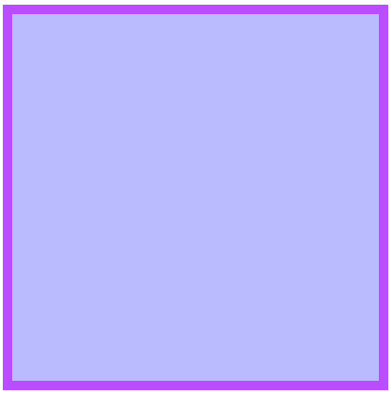
FeColorMatrix
SVG
Matrix:
SVG example:
<feColorMatrix type="matrix"
values="0 0 0 .33 0
0 .33 0 0 0
1 0 0 0 0
0 0 0 .7 0" />
Notes:
More informations on matrix and svg look at these links:
http://www.svgbasics.com/filters4.html
https://dvcs.w3.org/hg/FXTF/raw-file/tip/filters/index.html#feColorMatrix

Slide 35
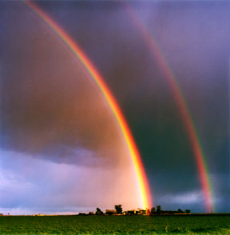
Gradients
SVG
As CSS3 gradient property:
Radial
Linear
Also defined in <defs> tag
Used with fill attribute

Slide 36
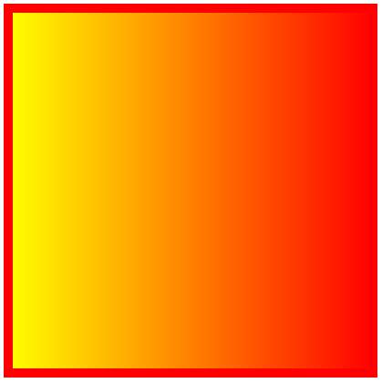
Linear Gradient
SVG
LinearGradient:
Don’t forget to change fill attribute on shape:
fill="url(#grad1)"
<linearGradient id="grad1">
<stop offset="0%" style="stop-color:rgb(255,255,0);
stop-opacity:1" />
<stop offset="100%" style="stop-opacity:1;
stop-color:rgb(255,0,0);" />
</linearGradient>
Notes:
More informations on matrix and svg look at these links:
http://www.svgbasics.com/filters4.html
https://dvcs.w3.org/hg/FXTF/raw-file/tip/filters/index.html#feColorMatrix

Slide 37
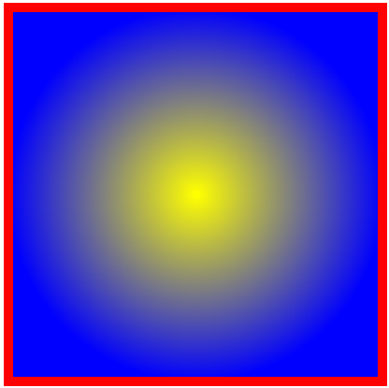
Radial Gradient
SVG
RadialGradient:
Don’t forget to change fill attribute on shape:
fill="url(#grad1)"
<radialGradient id="grad1">
<stop offset="0%" style="stop-color:rgb(255,255,0);
stop-opacity:1" />
<stop offset="100%" style="stop-opacity:1;
stop-color:rgb(0,0,255);" />
</radialGradient>
Notes:
More informations on matrix and svg look at these links:
http://www.svgbasics.com/filters4.html
https://dvcs.w3.org/hg/FXTF/raw-file/tip/filters/index.html#feColorMatrix

Slide 38
CSS with SVG
SVG
Of course you can take advantage of CSS with SVG
Even use CSS3 namespaces!
Like all other tags, SVG is part of the DOM
Easily accessible with CSS…
…and JavaScript!

Slide 39
<html>
<head>
<title>SVG example</title>
<style>
/* Define namespaces before anything else */
@namespace "http://www.w3.org/1999/xhtml";
@namespace s "http://www.w3.org/2000/svg";
figure { width: 180px; text-align: center; }
s|svg { margin: 10px 30px; height: 120px; }
s|svg polygon { opacity: .5; }
</style>
</head>
<body>
<h1>Look at my SVG!</h1>
<!-- ... -->
CSS3 namespaces and SVG

Slide 40
<!-- ... -->
<figure>
<svg>
<defs>
<filter id="f1">
<feColorMatrix type="hueRotate"
values="90"/>
<feGaussianBlur stdDeviation="5" />
</filter>
</defs>
<polygon … filter="url(#f1)" />
</svg>
<figcaption>SVG rocks</figcaption>
</figure>
</body>
</html>
CSS3 namespaces and SVG

Slide 41


Questions?

Slide 42
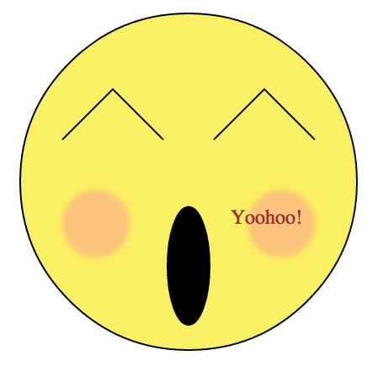
Exercise
SVG
Reproduce this image:

Slide 43
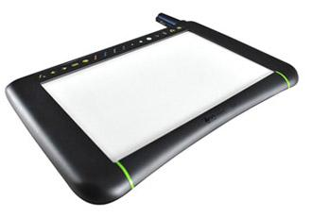
Canvas API
Graphics API

Slide 44
Presentation
Canvas API
JavaScript API
Only one DOM node: <canvas>
All your shapes are created programmatically
Bitmap rendering
Can draw in two and in three dimensions
Called respectively 2D and WebGL

Slide 45
Canvas context
Canvas API
The canvas tag:
Defines a drawable area
Has two contexts (one for 2D, the other for 3D)
Mandatory to create shapes
<canvas id="canvas1"></canvas>
<script type="text/javascript">
var context =
document.getElementById("canvas1").getContext("2d");
</script>
Notes:
You can also define the same canvas in JavaScript, as follows:
var canvas = document.createElement('canvas');
canvas.id = "canvas1";
var context = canvas.getContext("2d");
document.body.appendChild(canvas);

Slide 46
Canvas basics
Canvas API
Shapes’ origin are usually defined by a kind of cursor
You can move this cursor!
Just like hovering your pencil over your sheet
Call « stroke() » at the end of your drawing:
var context =
document.getElementById("canvas1").getContext("2d");
context.moveTo(100, 50); // 100px from left, 50px from top
context.stroke(); // Outputs the shape

Slide 47
Line
Canvas API
Used to draw a line:
Departure coordinates are defined by your cursor
context.lineTo(x, y);
context.moveTo(0, 0); // Move cursor at top left corner
context.lineTo(50, 50); // From 0,0 to 50,50

Slide 48
Rect
Canvas API
Used to draw a rectangle:
context.rect(x, y, width, height);
context.rect(550, 0, 300, 400);

Slide 49
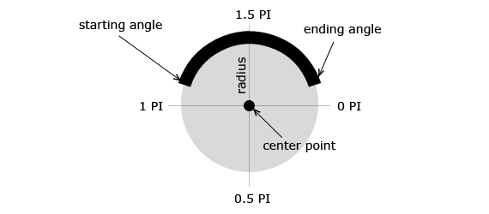
Arc
Canvas API
Used to draw an arc:
Before viewing the syntax, take a look at the following schema:
Source: http://www.html5canvastutorials.com

Slide 50

Arc
Canvas API
Used to draw an arc:
context.arc(x, y, radius, start, end, counterClockWise);
context.arc(250, 200, 75, Math.PI, 0, true);

Slide 51
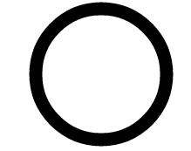
Arc
Canvas API
Also possible to draw circles:
context.arc(x, y, radius, start, end, counterClockWise);
context.arc(250, 200, 75, 2 * Math.PI, 0, true);

Slide 52
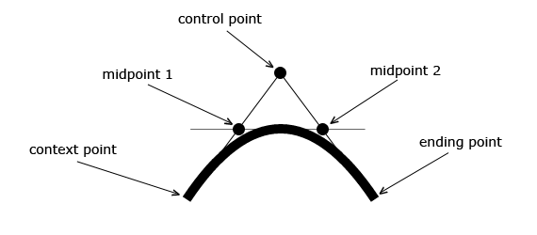
Curves
Canvas API
Two types of curves: quadratic and Bezier
Before viewing the syntax, take a look at the following quadratic curve schema:
Source: http://www.html5canvastutorials.com

Slide 53
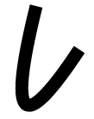
Quadratic Curve
Canvas API
Curve with one control point
Origin defined by your current cursor position
context.quadraticCurveTo(cX, cY, endX, endY);
context.moveTo(200, 0);
context.quadraticCurveTo(50, 300, 150, 150);

Slide 54
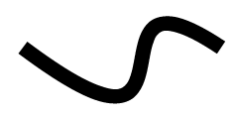
Bezier Curve
Canvas API
Curve with two control points
Origin defined by your current cursor position
context.bezierCurveTo(cX1, cY1, cX2, cY2, endX, endY);
context.moveTo(200, 0);
context.bezierCurveTo(300, 250, 150, 0, 300, 100);

Slide 55
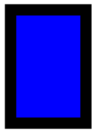
Context attributes
Canvas API
Change drawing style:
Be sure to set it up before « fill() » and/or « stroke() »!
context.rect(100, 150, 100, 150); // Draw a rectangle
context.lineWidth = 15; // Width in pixels
context.strokeStyle = "rgba(0, 0, 0, 1)"; // Black
context.fillStyle = "blue"; // Change inner color
context.fill(); // Fill rectangle
Context.stroke(); // Draw borders

Slide 56
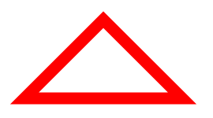
Canvas basics
Canvas API
Canvas allows to « auto-close » your shapes
Last point will be linked to first one by a straight line
context.beginPath(); // Start drawing the shape
context.moveTo(100, 300);
context.lineTo(200, 200);
context.lineTo(300, 300);
context.strokeStyle = "red";
context.lineWidth = 15;
context.closePath(); // End drawing the shape
context.stroke();

Slide 57

Text
Canvas API
Outputs a simple text
No need to use « stroke() » function
context.fillText(text, x, y);
context.fillText("Canvas rocks!", 100, 100);

Slide 58
Text
Canvas API
Change font defaults:
context.font = attributes;
context.font = "italic 40px Calibri";

Slide 59

Image
Canvas API
Drawing an image:
var oImage = new Image();
oImage.onload = function() {
context.drawImage(oImage, 700, 50);
};
oImage.src = "/img/success.png";

Slide 60
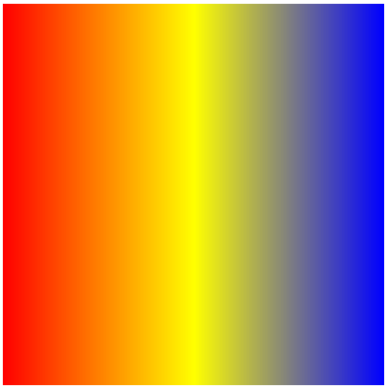
LinearGradient
Canvas API
Create gradient by relying on an imaginary line:
context.createLinearGradient(x1, y1, x2, y2);
var grd = context.createLinearGradient(100, 100, 500, 100);
grd.addColorStop(0,"red");
grd.addColorStop(.5, "yellow");
grd.addColorStop(1, "blue");
context.rect(100, 100, 500, 500);
context.fillStyle = grd;
context.fill();

Slide 61
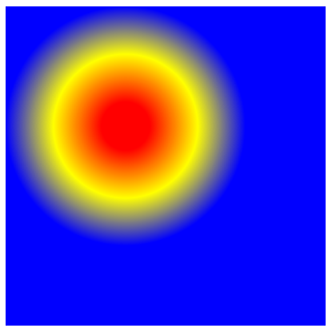
RadialGradient
Canvas API
Create gradient by relying on two imaginary circles:
context.createRadialGradient(x1, y1, r1, x2, y2, r2);
var grd = context.createRadialGradient(250, 250, 30, 250,
250, 150);
grd.addColorStop(0,"red");
grd.addColorStop(.5, "yellow");
grd.addColorStop(1, "blue");
context.rect(100, 100, 500, 500);
context.fillStyle = grd;
context.fill();

Slide 62
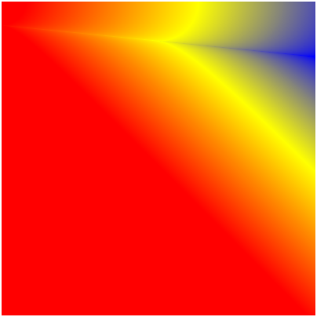
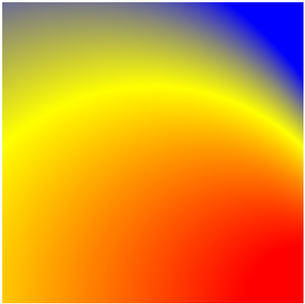
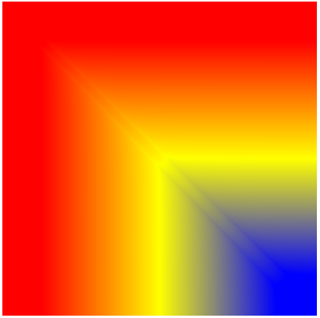
RadialGradient
Canvas API
With radial gradients, you can put the two circles where you want
Allows all gradient types you need
(100, 100, 30, 500, 100, 70)
(500, 500, 75, 100, 500, 500)
(150, 150, 5, 450, 450, 10)

Slide 63

WebGL (Canvas 3D)
Canvas API
Canvas 3D API (WebGL):
Based on OpenGL
Built in modern browsers without any plug-ins use
Use graphic processing unit (GPU) through GLSL language

Slide 64
WebGL (Canvas 3D)
Canvas API
Canvas 3D API (WebGL):
Some examples:
http://mrdoob.com/
http://learningwebgl.com/blog/?page_id=1217
http://triggerrally.com/

Slide 65
We need to go deeper…
Canvas API
Canvas is enriched by open source libraries
Here are some of them:
Processing.js
KineticJS
Fabric.js
Easel.js
…

Slide 66
Web Laboratory example
Canvas API
Discover a SUPINFO student gaming library
Use canvas to reproduce game environment
Gravity, collisions, object moving, NPC interactions…
Four classes for most cases handling
Element, Sprite, Game, Room
Discover it at http://jsglib.no-ip.org/
Actually in version 2.1
For more informations, please contact Adrien Guéret

Slide 67
Questions?

Slide 68

SVG or Canvas ?
Graphics API
Both can draw, so which one to use?

Slide 69

Advantages
SVG or Canvas ?
SVG is great because:
Simple syntax
DOM elements allowing to use CSS and JS
More accessible as everything is written in markups
Canvas is great because:
It’s all dynamic
Everything is a pixel
It’s really fast!

Slide 70
Disadvantages
SVG or Canvas ?
But SVG is:
Slow when DOM complexity increases
DOM API remains slightly slow
Only bi-dimensional
But Canvas has:
No native animation API
Poor text rendering capabilities
No ARIA support

Slide 71
Conclusion
SVG or Canvas ?
SVG is designed for:
Cross-platform rendering
Data charts, interactive UI, …
Canvas is designed for:
High speed rendering (for example games)
Image editing, color picker, …

Slide 72
Questions?

Slide 73
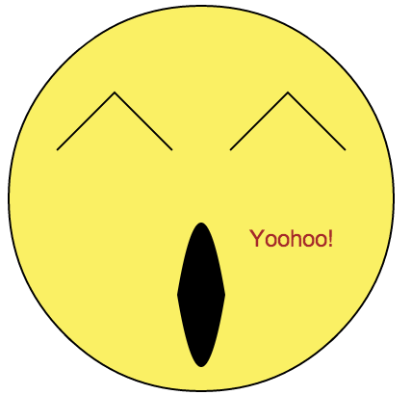
Exercise
Canvas
Reproduce this image:
Notes:
- Canvas can’t draw an ellipse as
easily as SVG can. You’ll need to
use two curves instead
- Filters are way more hard to do in
canvas, so drop the cheekbones!

Slide 74

The end
Graphics API
Thanks for your attention

